Slide 1
CECS 579 SURVEY PRESENTATION
BLUETOOTH LOW ENERGY
ARE WE COMPROMISING SECURITY WITH LOW ENERGY?
KARISHMA MEHTA (013656966)

Slide 2
Contents
Introduction
Difference between Bluetooth and Bluetooth Low Energy
Comparisons between Zigbee and BLE
Applications of Bluetooth Low Energy
Case study: How is BLE used in WSN’s (Eg: Inter-Vehicular Communications
What is Bluetooth Low Energy Good for?
Security threats to BLE and how to overcome them

Slide 3
Introduction
Also known as Bluetooth Smart or Version 4.0+^{[1]}
BLE can be thought of as a wireless personal area network aimed at designing novel applications in healthcare, security, fitness applications
It is similar to classic bluetooth except in that it provides better reduced power consumption while having the same communication range
Bluetooth Smart or Bluetooth 4.0 is supported by many operating systems like Android, iOS, Windows Phone, Linux, Windows 8
It is also predicted that by 2018 more than 90% devices with Bluetooth will support Bluetooth Smart.

Slide 4
Introduction (Contd..)
Bluetooth LE is also known as power and application friendly version of bluetooth which was built for the Internet of Things (IoT).
What is means for consumers?
Key features:
Wireless protocol allowing for multi-vendor interoperability.
Extreme low power consumption which makes it possible to run on coin-cell batteries
128-bit AES encryption

Slide 5
How much energy does traditional Bluetooth use?
Traditional Bluetooth is connection oriented. When a device is connected, a link is maintained, even if there is no data flowing.
Using sniff modes it allow devices to sleep, reducing power consumption thereby giving months of battery life
Peak transmit current is typically around 25mA
Even though it shows to be consuming less power than other radio standards, it is still not low enough power

Slide 6
Bluetooth vs Bluetooth LE^{[2]}
Technical Specification | Classic Bluetooth | Bluetooth LE
Max distance | 100 m | >100 m
Throughput | 0.7-2.1 Mbit/s | 0.27 Mbit/s
Power Consumption | 1W | 0.01 to 0.5W
Security | 56/128-bit | 128-bit AES with Counter Mode CBC-MAC
Latency | 100ms | 6ms
Peak current consumption | <30 mA | <15 mA
Data rate | 1-3 Mbit/s | 1 Mbit/s

Slide 7
Bluetooth vs ZigBee vs Wi-Fi 802.11
 | Bluetooth | ZigBee | Wi-Fi 802.11
Data rate | 1 Mbit/s | 20,40 and 250 kbits/s | 11 and 54 Mbits/s
Range | 10m | 10 to 100m | Up to 100m
Frequency | 2.4 GHz | 868 MHz (Europe), 900 to 928 MHz (America) | 2.4 and 5 GHz
Power Consumption | Low | Very low | High
Network Applications | Ad-hoc, small network | Ad-hoc, peertopeer,mesh,star | Point to hub

Slide 8
Applications of BLE^{[4]}
Proximity
Heart rate monitor
Inter-vehicular communications
Remote control
Example of proximity:
It can enable proximity detection
I’m in car
I’m in office
I’m in meeting room

Slide 9
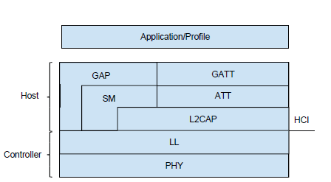
Bluetooth Low Energy Architecture^{[6]}

Slide 10
Architecture^{[6]}
The BLE protocol stack is divided into two parts :
Controller
Host
Controller consists of:
Link Layer: medium to establish communication between two devices. Two roles are defined : Master(Central) and Slave(Peripheral).
Physical Layer: Takes care of handling incoming and outgoing bits

Slide 11
Architecture Contd^{[6]}
L2CAP: Encapsulate data channels for the upper layers providing traffic management.
ATT Protocol defines the communication between the Master and Slave.
The GATT Profile establishes a framework for discovering the data stored in the Attribute protocol and exchanging characteristics between devices.

Slide 12
BLE for Inter-Vehicular Communications^{[4]}
Research paper provided case study on this topic.
Bluetooth Low Energy was not developed with vehicular applications in mind.
Nevertheless a piconet between one or more vehicles can be engineered using off-the-shelf smartphones fixed to a car’s dashboard.
We can imagine that in a near future, where entertainment systems in cars will provide a stronger bound between one’s smartphone and car (e.g. Apple CarPlay [2]).
The BLE interface from the smartphone or from the car itself can be used for fast and reliable communication to neighbour vehicles.

Slide 13
BLE for Inter-Vehicular Communication^{[5]}
There are two modes of operation:
Single Mode: Each smartphone will start as Central device and will wake up manually its Peripheral role via a button on the device itself. Note that once a device switches to Peripheral it will still maintain a Central role in a different queue allowing the device to discover other Peripherals around even whilst broadcasting.

Slide 14
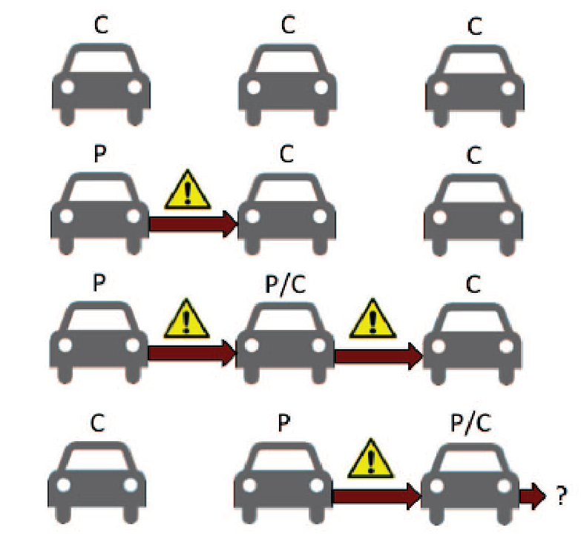
Inter-Vehicular Communication^{[4]}

Slide 15
Inter-Vehicular Communication^{[4]}
Multi-hop Mode: Each device will start in Central mode and will activate its Peripheral role manually on the device itself or upon receiving a message to rebroadcast.
In our case the first vehicle on the left will manually trigger a message that will be received by all cars in range. The car in the middle will rebroadcast the messages to the third car (out of range from the first) and will have for a certain period of time both Peripheral and Central roles active at the same time.
Once the middle smartphone receives the first message as a Central device it will activate its Peripheral manager and rebroadcast messages whilst still receiving new ones from the first car.

Slide 16
What is Bluetooth Low Energy Good for?
Connecting the things we carry with us:
Watches: remote display from other devices
Tags: locate objects or keep track of them (e.g. warning if you walk away)
Health/fitness sensors (e.g. pedometer in your shoes)
Body sensors (e.g. blood pressure, pulse rate, etc)

Slide 17
What is Bluetooth Low Energy Good for?
Connecting the things we carry with us:
Watches: remote display from other devices
Tags: locate objects or keep track of them (e.g. warning if you walk away)
Health/fitness sensors (e.g. pedometer in your shoes)
Body sensors (e.g. blood pressure, pulse rate, etc)

Slide 18
Low Energy, Low Privacy^{[3]}
The main thing we need to know about any BLE-connected wearable devices and beacons is that they are constantly broadcasting an ID together with a MAC address, which is unique for each device.
To make tracking a particular gadget more difficult, the broadcast MAC address can change every time, so that only a device that has been previously paired with it would be able to “recognize” the wearable.

Slide 19
Ways to overcome threats^{[3]}
Check if your wearable changes its broadcast MAC address constantly (and in whole), making it unrecognizable for sniffers of all kinds.
In addition to that, make sure there’s no unique ID being sent out openly; it’d also be better if there were no possibility for the end user to define such an ID, like “Julia’s FitBit” or “Max’s watch” — this is a case where privacy trumps usability.
Another general recommendation is to take time and read the most recent specification of the BLE standard: new security-related possibilities are being implemented often, and the more you know about them, the better protection you can ensure for your products.

Slide 20
References
[1] Bluetooth Wesbsite www.bluetooth.com
[2] Bluetooth Low Energy (Wikipedia)
[3] https://stanfy.com/blog/bluetooth-low-energy-security-issues-and-how-to-overcome-them/
[4] Bluetooth Low Energy for Inter-Vehicular Communications(Walter Bronzi, Raphael Frank)
[5] Bluetooth: With Low Energy comes Low Security (Mike Ryan)
[6] Bluetooth low energy – F. Martelli

